Slide 1
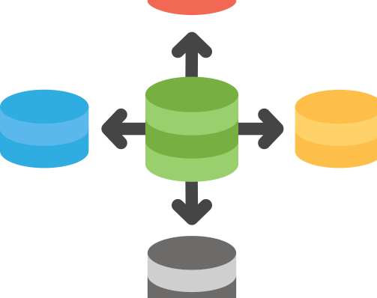
KAIZEN DAY
Distributed SQL Databases: Modern Approach to OLTP Systems

Slide 2
Agenda
Introduction
OLTP Basics
What is Distributed SQL?
Core Features
Architecture Overview
Comparison
Popular Databases
Demo: Query Flow & ACID
Use Cases & Future Trends

Slide 3
Introduction
OLTP systems power transactional workloads.
Traditional RDBMS struggles with scalability & global consistency.
Distributed SQL solves these challenges.

Slide 4
OLTP Basics
OLTP Characteristics: High transaction volume, ACID compliance.
Challenges:
  Vertical scaling limits.
  Single-region deployments.
  Expensive hardware upgrades.

Slide 5
What is Distributed SQL?
Relational database distributed across nodes.
Maintains SQL semantics & ACID guarantees.
Cloud-native, horizontally scalable.

Slide 6
Core Features
Horizontal scalability.
Strong consistency via consensus.
Geo-distribution.
Fault tolerance & high availability.

Slide 7
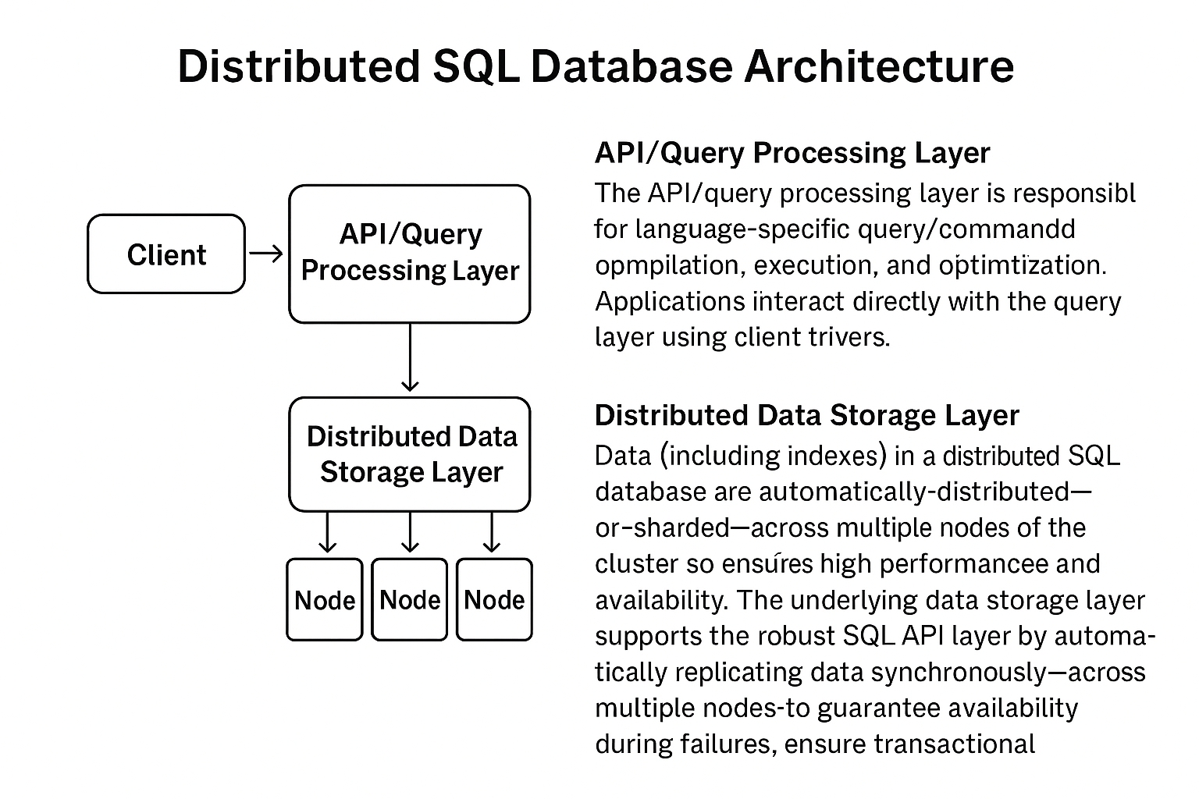

Slide 8
Feature | Traditional RDBMS | Distributed SQL
Scalability | Vertical | Horizontal
Consistency | Single-node | Multi-node strong
Fault Tolerance | Limited | High
Geo-distribution | No | Yes
Comparison Table

Slide 9
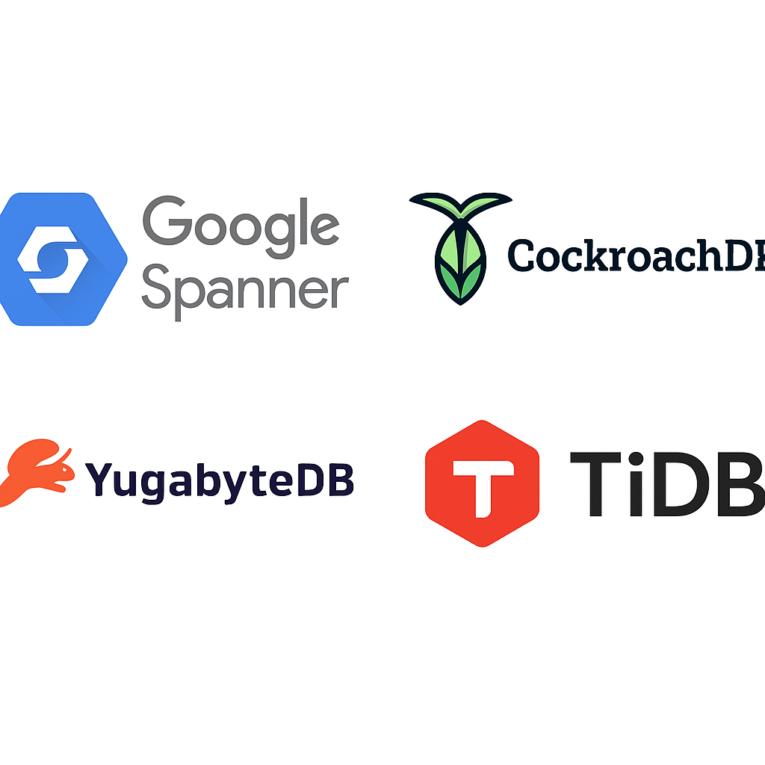
Popular Distributed SQL Databases
Google Spanner
CockroachDB
YugabyteDB
TiDB

Slide 10
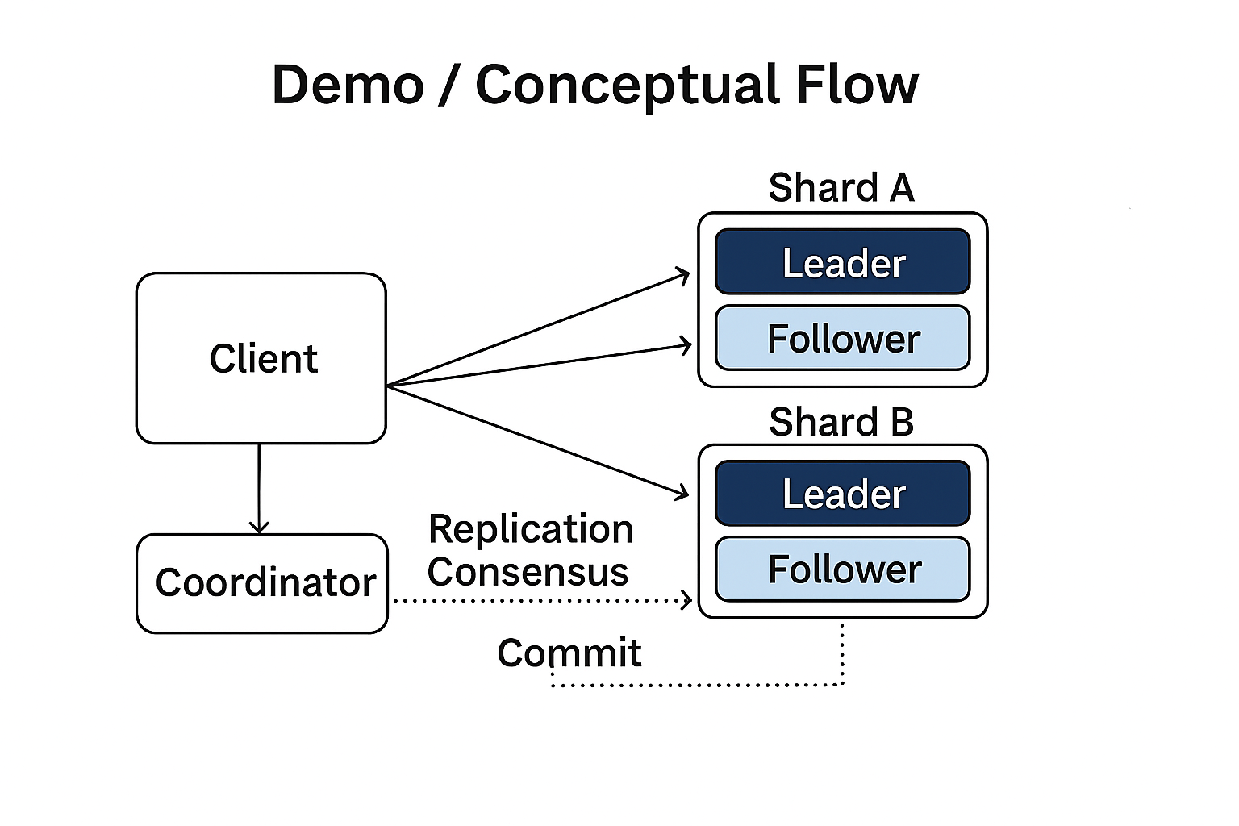
Conceptual Flow
Steps:
  Client sends query → Coordinator parses.
  Coordinator plans execution across shards.
  Leader replicates to followers (Raft consensus).
  Majority commit → Coordinator confirms → Client success.
ACID:
  Atomicity: All-or-nothing via consensus.
  Consistency: Majority agreement before commit.
  Isolation: MVCC prevents conflicts.
  Durability: Data persisted on multiple nodes.

Slide 11
Use Cases & Future Trends
Use Cases:
Global e-commerce.
Financial systems.
SaaS multi-region apps.
Future Trends:
HTAP (Hybrid transactional/analytical).
AI-driven query optimization.

